Slide 1
Object-Oriented Programming (OOP)
Week – 11
April 20-24, 2020
Instructor: Basit Ali
Email: basit.jasani@nu.edu.pk
Object-Oriented Programming (OOP)

Slide 2
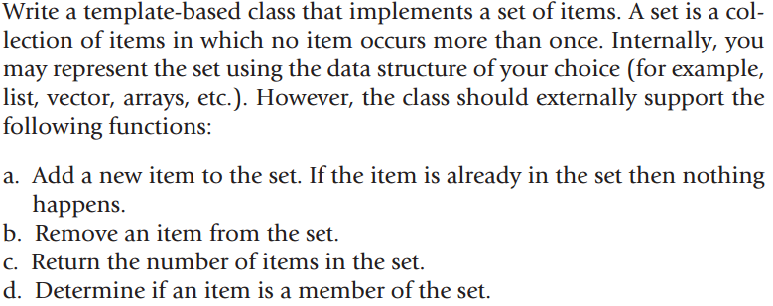
Exercise # 1

Slide 3
Exercise # 2
In this task, you have to calculate the percentage of marks obtained in three subjects (each out of 100) by student A and in four subjects (each out of 100) by student B. Create an abstract class 'Marks' with an abstract method 'getPercentage'. It is inherited by two other classes 'A' and 'B' each having a method with the same name which returns the percentage of the students. The constructor of student A takes the marks in three subjects as its parameters and the marks in four subjects as its parameters for student B. Create an object for each of the two classes and print the percentage of marks for both the students.

Slide 4
Exercise # 3
The murder of a young boy Danny in a small coastal town brings a media frenzy, which threatens to tear the community apart. As the mystery around Danny's death deepens, DI Hardy and DS Miller must work fast to identify the key suspects. DI Hardy wants you to make a system that keeps the track of all the suspects' travel logs. The system operates both individual taxis and shuttles. The taxis are used to transport an individual (or small group) from one location to another. The shuttles are used to pick up individuals from different locations and transport them to their several destinations. When the system receives a call from an individual, hotel, entertainment venue, or tourist organization, it tries to schedule a vehicle to pick up the fare. If it has no free vehicles, it does not operate any form of a queuing system. When a vehicle arrives at a pick-up location, the driver notifies the system. Similarly, when a suspect is dropped off at their destination, the driver notifies the system.

